Slide 1
Data Logger Block Diagram
Data Logger
Shield
Arduino Uno
SD Memory Card
SCK
D13
MISO
D12
SPI Bus
MOSI
D11
SS/CS
D10
Temperature
Sensor
(located on Proto Board
Battery Backup
Real Time Clock
I2C Bus
TC74A0-5.0VAT
SCL/A5
SDA/A4
1
2
3
4
5
SCL
SDA
+5V
GND
4/21/14

Slide 2
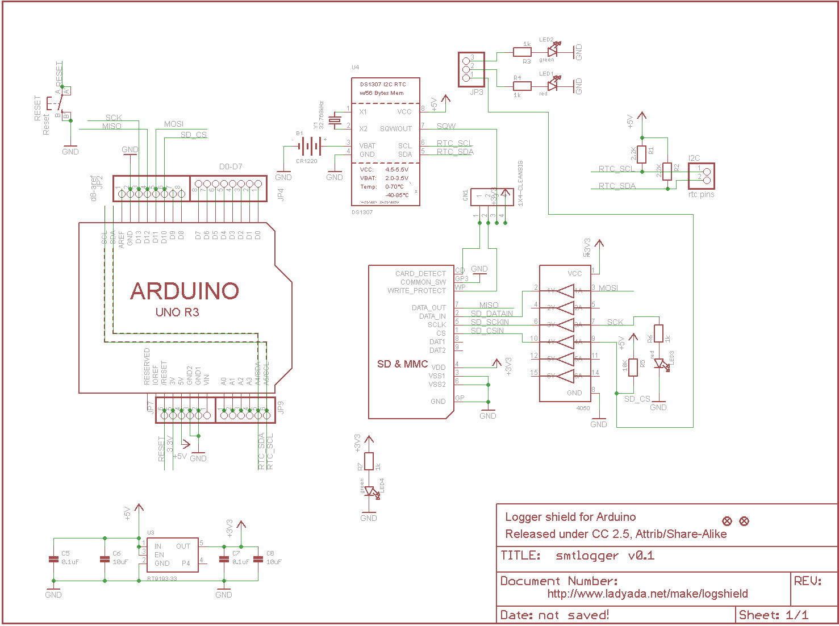
Data Logger Block Schematic

